Slide 1

Save Money V.S. Make Money
CS 706: Data Management in the Cloud
Tian Guo
April 23, 2012

Slide 2
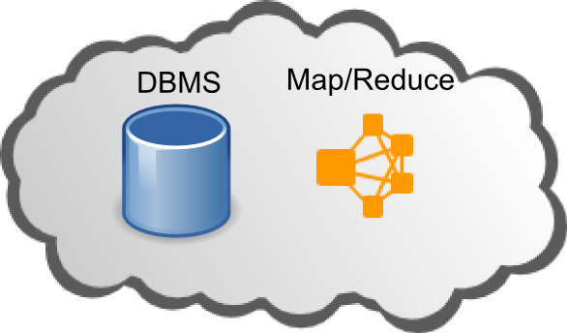

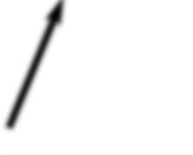

Overview of Two Papers
Feasible Pricing Mechanism
Economically Usage
EPFL
Duke
Predicting Cost Amortization
for Query Services
No One (Cluster) Size Fits All: Automatic Cluster
Sizing for Data-intensive Analytics,

Slide 3
Preliminary Duke
Cluter Sizing Problem:
right cluster size
type of resources to use in the cluster platform
job configurations that best meet her performance needs
Elastisizer:
a system by which users can
express cluster sizing problems as queries in a declarative fashion.
provide reliable answers to these queries
use an automated technique that uses a mix of job profiling, black-box and white-box models, and simulation.

Slide 4
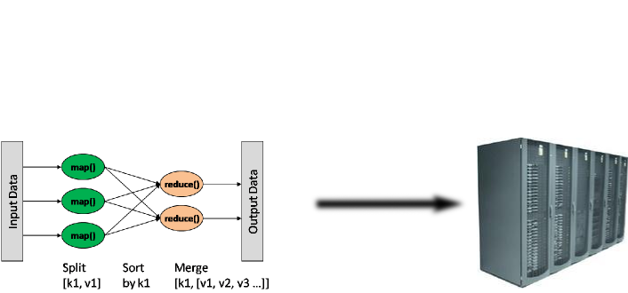
Preliminary Duke
MapReduce Abstraction
One job of MapReduce:

Slide 5
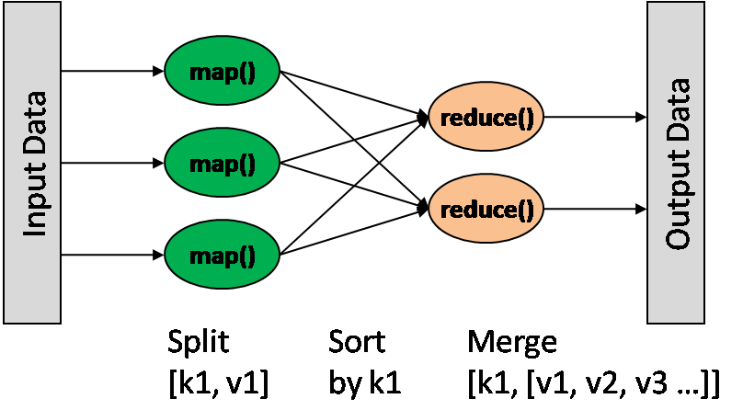
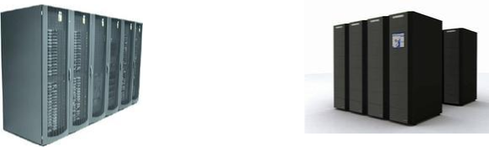



Motivation Duke
Tuning the cluster size for elastic workloads

Slide 6
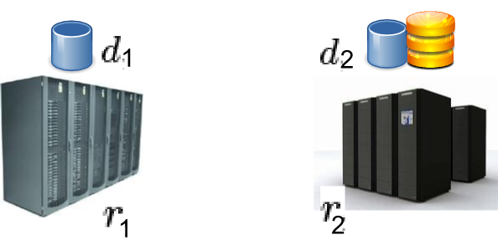
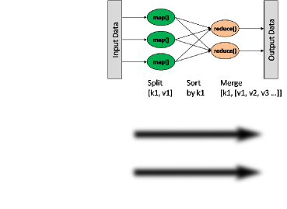
Motivation Duke
Planning for workload transition from a development cluster to production

Slide 7
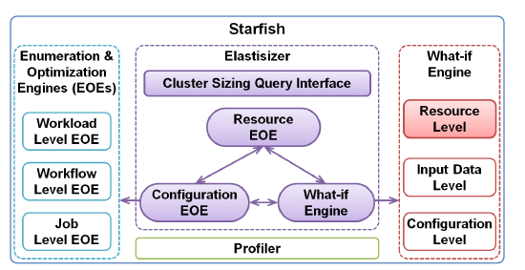
Architecture Duke
Starfish:
is a self-tuning system for analytics on large datasets
builds on Hadoop while adapting to user needs and system workloads automatically
no need for users to tune.

Slide 8

Architecture Duke
Interface
(1)workload: profile of job, data
(2)search space for cluster resource: singleton set, multidimensional space
E.g. : for use case 1, , cluster resource of virtual job is
known.
(3)search space for job configuration: singleton set, multidimensional space
E.g. : for use case 2, , search space of job
configuration is undetermined and multi-dimensional space.
(4)performance requirement: execution time and cost

Slide 9
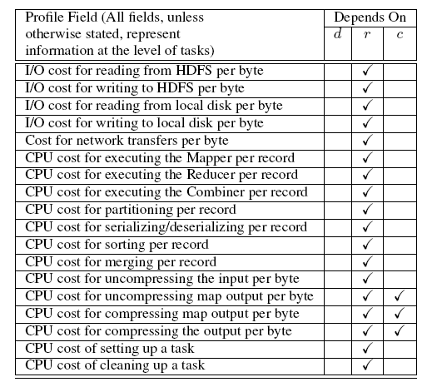
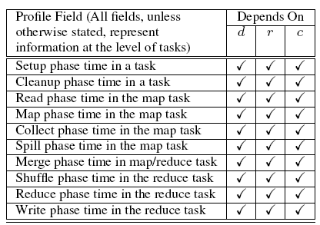
Architecture Duke
Profile of job
Cost

Slide 10
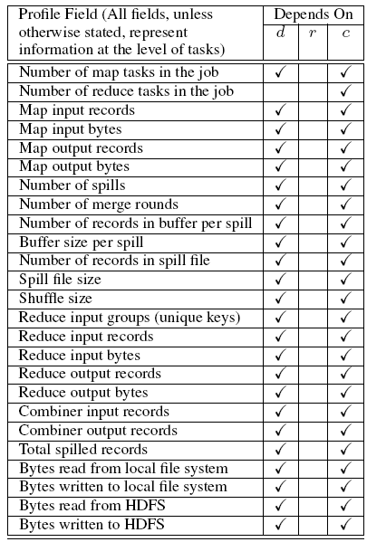
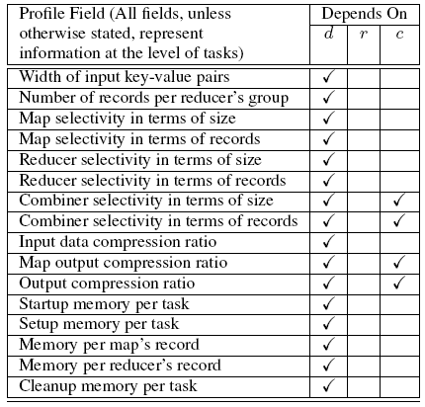
Architecture Duke
Profile of job
Dataflow

Slide 11
Architecture Duke
Starfish:
is a self-tuning system for analytics on large datasets
builds on Hadoop while adapting to user needs and system workloads automatically
no need for users to tune.

Slide 12
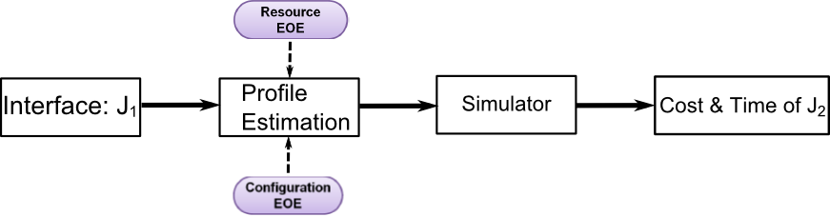
Architecture Duke
What-if Engine
Dotted line: In case 1, the resource space is a singleton set, so there is no need to make resource EOE.

Slide 13
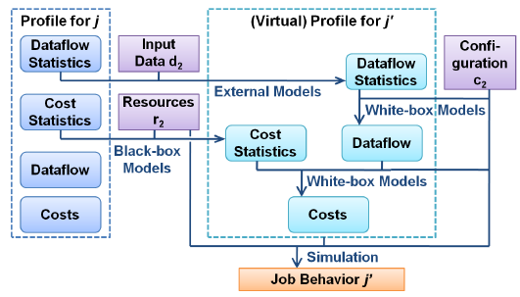
Architecture Duke
Profile Estimation

Slide 14


Model Duke
Cost Statistic Black Box Model
:cost statistic in the job profile for the source cluster.
:cost statistics fields in the virtual profile for target cluster
Cost statistic is mostly dependent on recourse
Training benchmark: different <p, d, c> combinations
3 training benchmark selection method:
Apriori: all jobs are known in advance. Randomly selection.
Fixed: predetermined jobs that give different degrees of resource usage
Custom: a small synthetic set of jobs that cover a large domain

Slide 15
Architecture Duke
Profile Estimation

Slide 16
Model Duke
Dataflow Statistic
(1) the logical dataflow sizes through the job’s phases are proportional to the
input data size.
(2) dataflow statistics fields in the virtual profile will be the same as those in
the profile of job j given as input.
Dataflow and Cost
(1) Dataflow: estimated dataflow statistic & configuration setting of virtual job
(2) Cost: estimated cost statistic and dataflow

Slide 17
Architecture Duke
What-if Engine
Dotted line: In case 1, the resource space is a singleton set, so there is no need to make resource EOE.

Slide 18
Architecture Duke
Starfish:
is a self-tuning system for analytics on large datasets
builds on Hadoop while adapting to user needs and system workloads automatically
no need for users to tune.

Slide 19
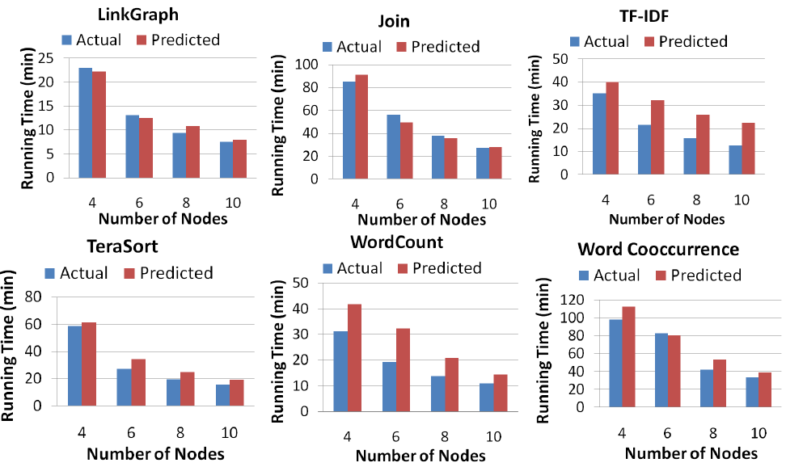
Experiment Duke
Use Case 1

Slide 20
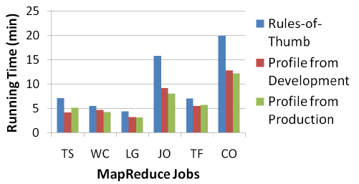
Experiment Duke
User Case 2

Slide 21
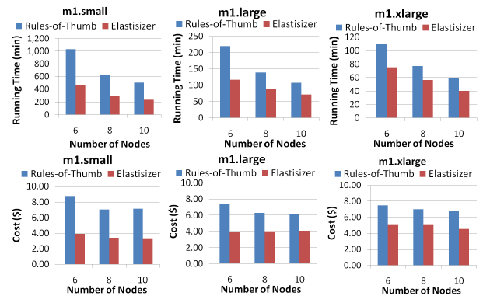
Experiment Duke
Multi-objective Cluster Provisioning

Slide 22
Architecture Duke
Starfish:
is a self-tuning system for analytics on large datasets
builds on Hadoop while adapting to user needs and system workloads automatically
no need for users to tune.

Slide 23
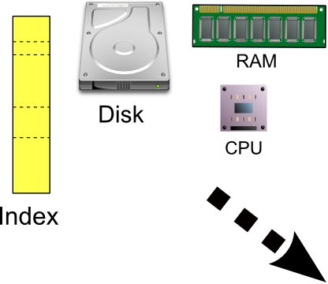
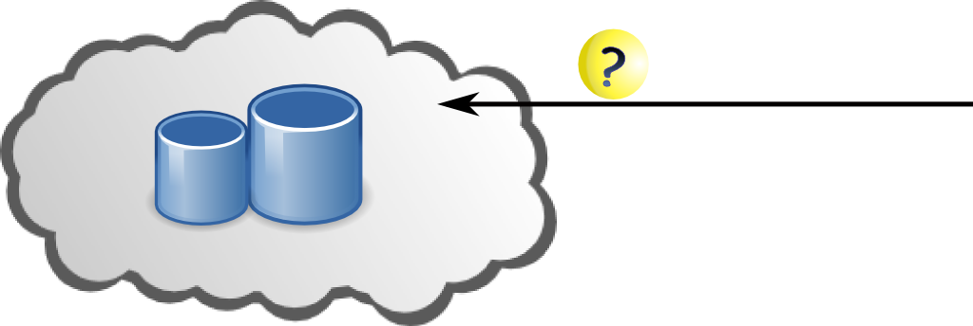


Motivation EPFL
In order to ensure the economic viability of the provider, the building and maintenance cost of new structures has to be amortized to a set of prospective query services that will use them.

Slide 24
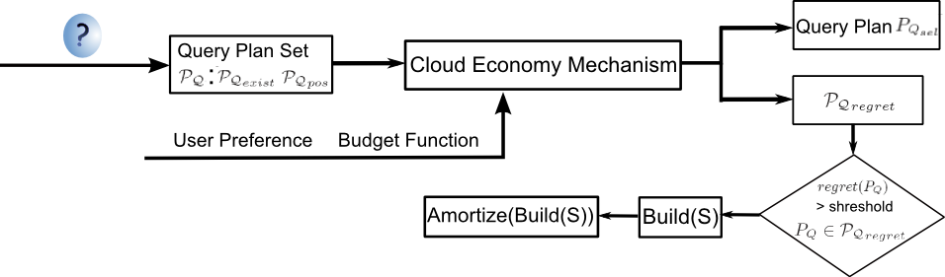
Architecture EPFL

Slide 25
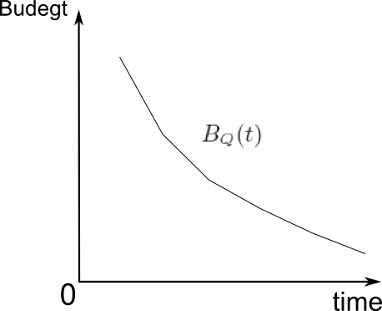
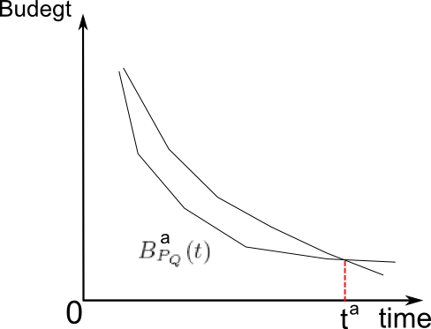
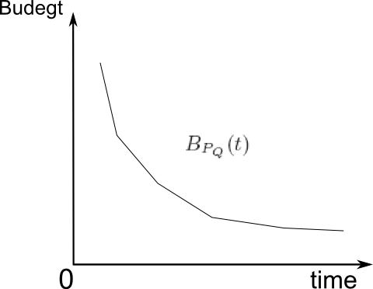
Cloud Economy EPFL
Input:
The part of that is covered by is stored in

Slide 26















Cloud Economy EPFL

Slide 27
Architecture EPFL

Slide 28
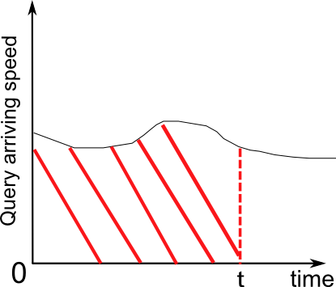
Amortization EPFL
Objective: amortize the cost of building new structure to the following n prospective queries.
Query arriving speed is dynamic
Number of prospective queries: time, integral on query speed

Slide 29
Amortization EPFL
Time
lifetime of S:
(1)S is not used in the prospective queries
(2)the data related to S is updated
Define:
usefulness is the probability that the structure S is useful to
query
stability is the probability that the data related to a structure
S is stable

Slide 30
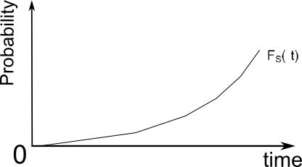
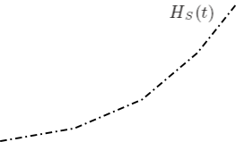
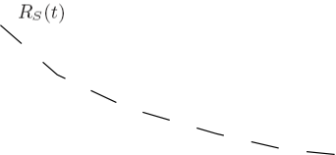


Amortization EPFL
Time
The cumulative failure probability is
This failure probability evaluates the probability that the system fails at time t,
no matter if it has failed before.
The reliability : the quality of S that
indicates that the non-amortized building
cost of S at time t will be amortized in the
future, (t,∞).
The hazard rate : represents the instantaneous conditional failure of a structure S and by definition it is calculated as: h(t) = f(t)/R(t)

Slide 31
Amortization EPFL
Time
The balancing rate at time t :
the difference of the reliability and hazard at this time for a structrue:
The integral of in a time interval [t1, t2] represents the cumulative balance of this pair of tends in this interval.
Maximal cumulative probability: full amortization of the cost of S will be achieved
in this interval

Slide 32




Amortization EPFL
Number of Prospective Queries
The probability that at time t the number of arrived queries is k is given as:
For a new structure S, the usage of it inselected query plans, is a function of time t and query arrivals k.

Slide 33
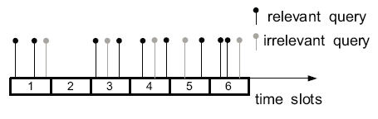
Amortization EPFL
Data Regression
Usefulness
Stability
The time series of query arrivals
Extract queries that utilizes the structure
Delete data points irrelevant to structure
Get merged time series

Slide 34
Architecture EPFL

Slide 35
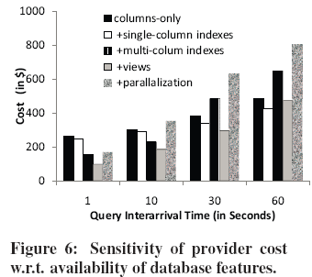
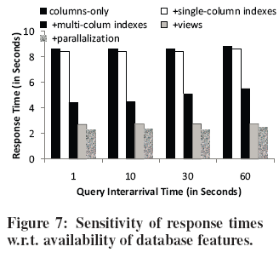
Experiment EPFL
Cost and Performance Improvement of Structures

Slide 36
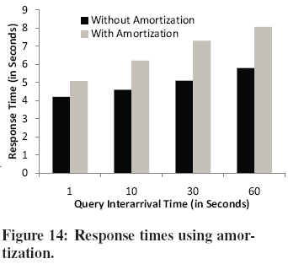
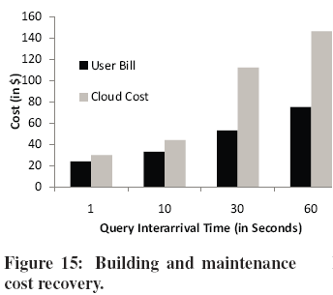
Experiment EPFL
Effect of cost amortization

Slide 37
Architecture EPFL

Slide 38
Thank you all!

